Slide 1


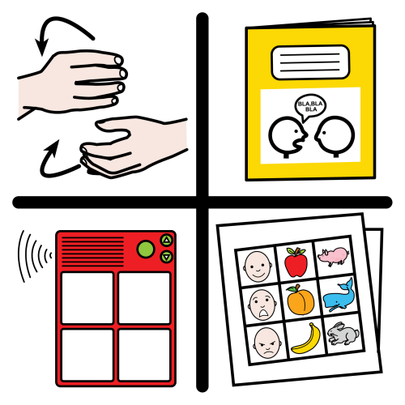














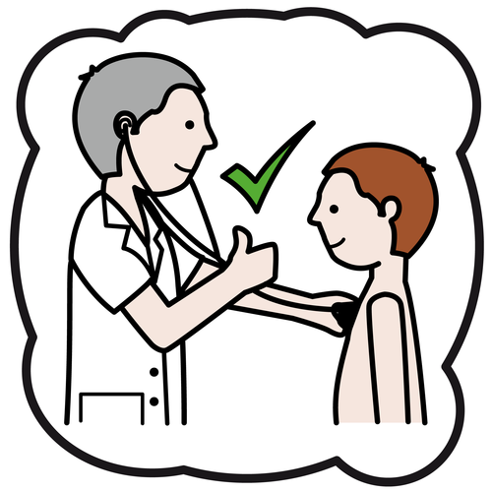


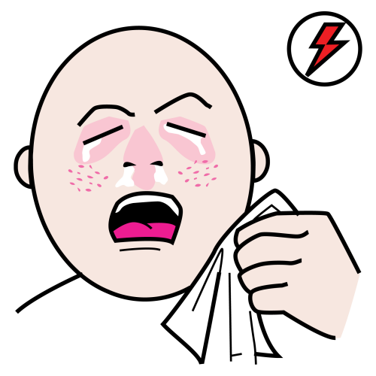
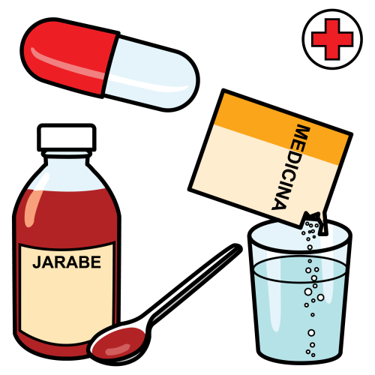





















My name is
You can help me communicate by…..
My birthday is on the
My name is
Hello
Hello
bye
How I communicate….
How I communicate….
My favourite thing….
You’re way off
Ask me a yes/no question.
almost
You got it!
Emergency contact
My doctor:
Emergency contact:
Emergency contact:
Email:
My sight is….
Things I like
My hearing is…
I do not like
Medical info
My mobility is…
I live in
Existing conditions:
Allergies:
Medication:
Other info:
I understand……
My phone number is
I enjoy …….hobbies
good
tired
pain
bad
yes
ok
Can’t find what I need to say
No/not
I like to eat……
sick
hot
cold
ill
I’m lost
I don’t know
I don’t understand
excuse me

Slide 2









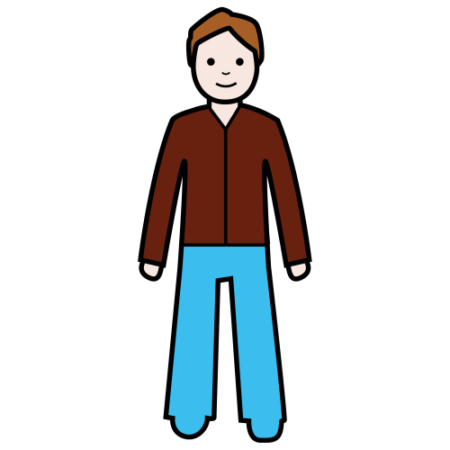
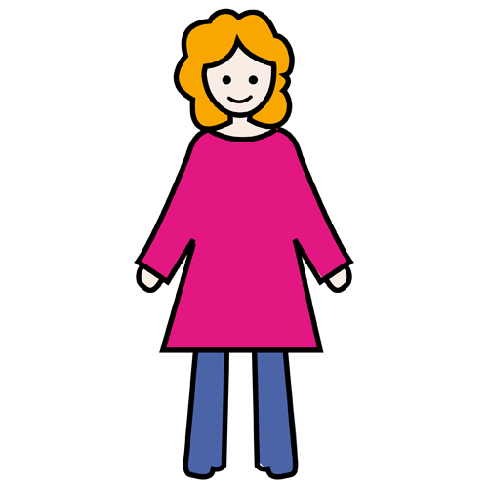




























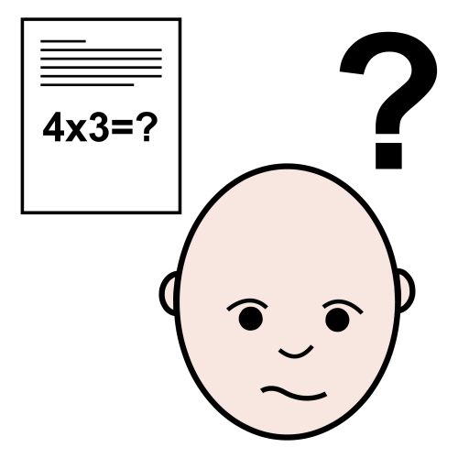




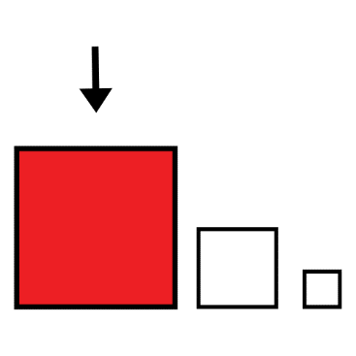





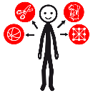





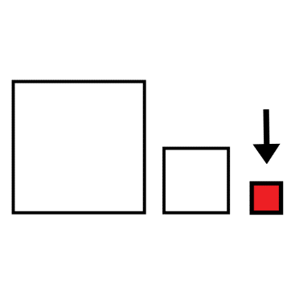






























I / me
you
he/him
she
family
what
when
where
why
man
woman
child
staff
friend
who
How much?
Can I ….?
which
go
want
do/make
look/see
/watch
ask/say/
tell/talk
think
give/get
take
put
try
know
need
stop
feel
come
listen/hear
like
have
work
find
change
wait
problem
help
more
important
idea
nice
little
hard/difficult
fast
colour
It’s about
thing
personal item
Food/Drink
all
done/finish
different
same
big
easy
slow
shape
nature/earth
transport
sport/ leisure
place
because
with
this/that
but
time
day
night
again
T.V
bag
money
wash/shower
outside
place
Home/inside
community
place
bathroom
yesterday
tomorrow
now
later
I’m sorry
please
Thank you
I want
to talk

Slide 3
My name is
How I communicate….
yes
ok
Can’t find what I need to say
No/not
I’m lost
I don’t know
I don’t understand
excuse me

